Slide 1

Communicate Effectively

Slide 2


Objectives
Communication methods
Effective communication
Barriers to communication
Effective communication in Scouting

Slide 3

Tool

Slide 4



The Basics

Slide 5

Communication Methods

Slide 6
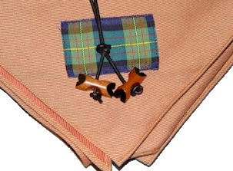

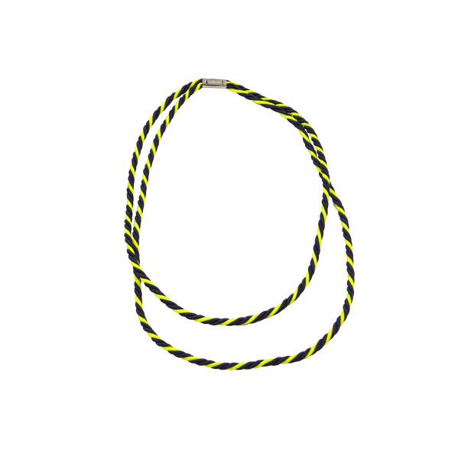

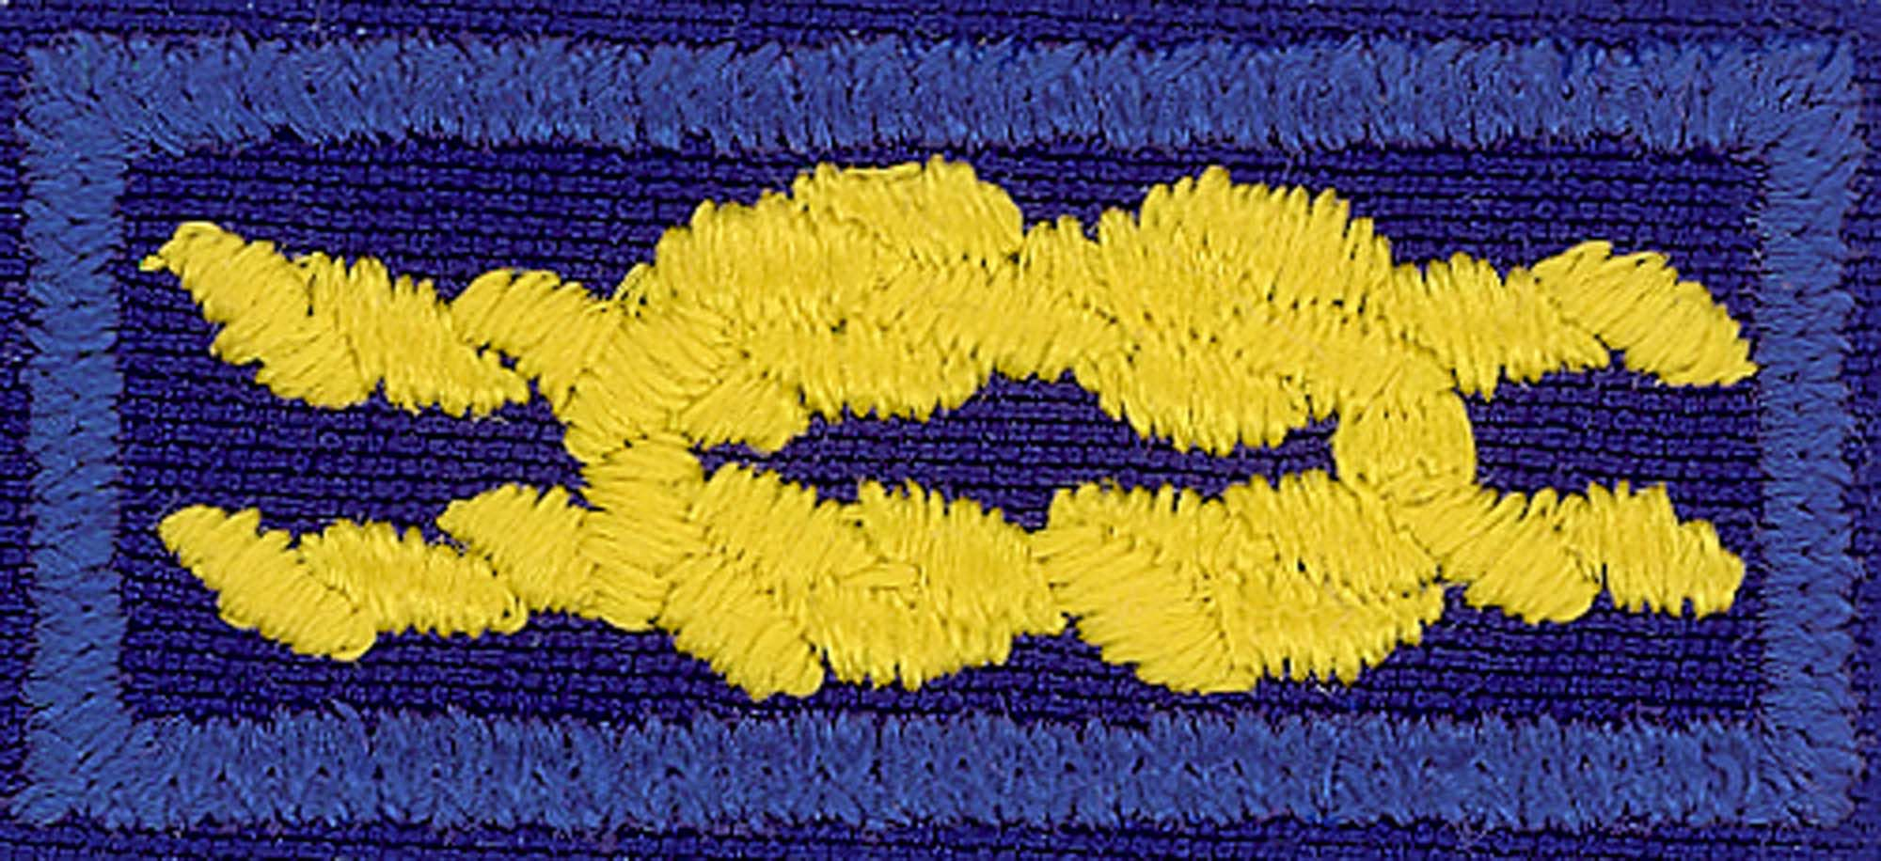
Non-verbal Communication

Slide 7
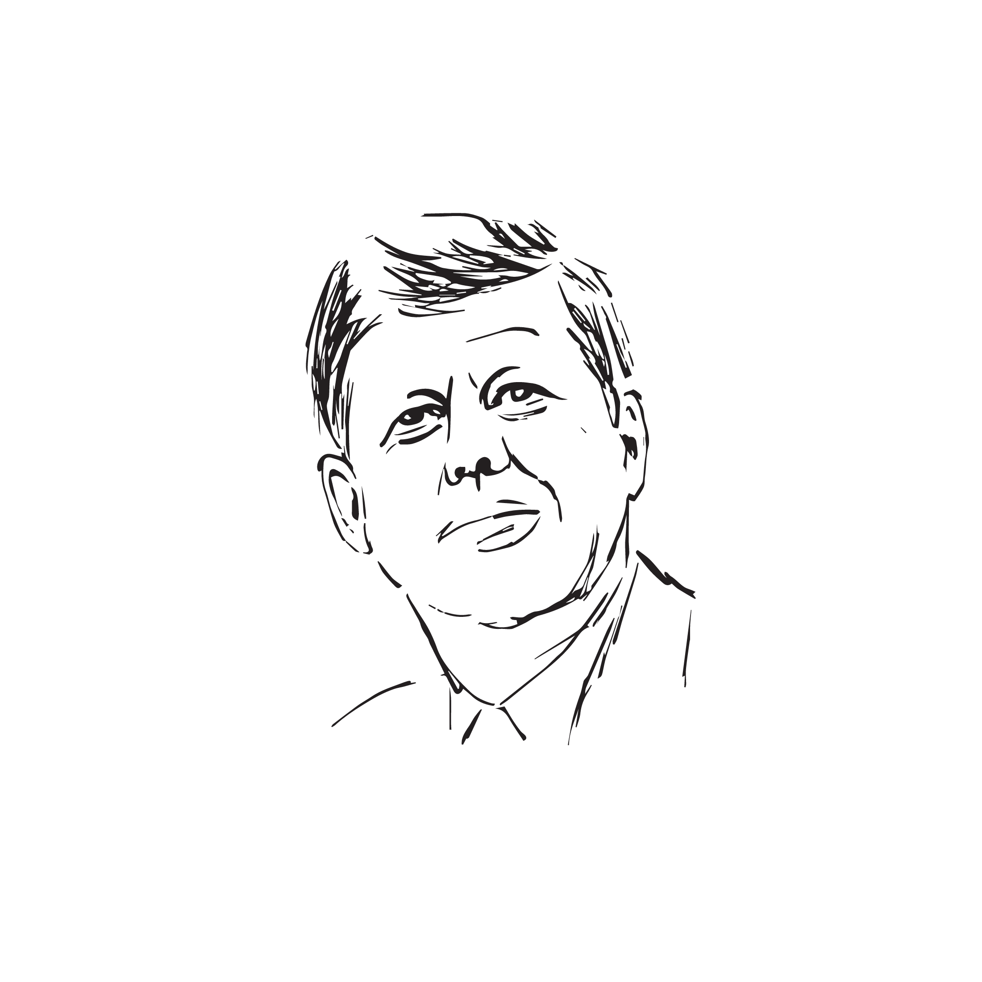

Drive Vision, Mission & Values

Slide 8

Barriers

Slide 9
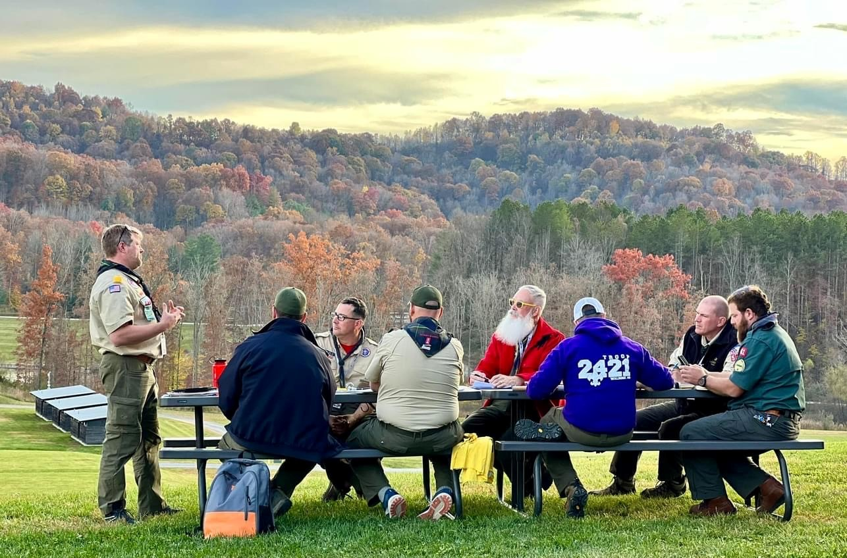
Group Discussion

Slide 10

Some Ideas
Find Common Ground
Be Sincere
Establish Authority
Communicate Clearly

Slide 11

Communication…
Tool of leadership
Essential to effective teams
“Common ground”
Clear and concise
Written, verbal, nonverbal, and virtual

Slide 12
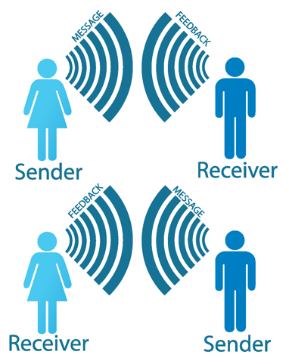
Key Points

Slide 13

Also…
Recognize the barriers
Consider the needs of the group

Slide 14

Conclusion

Slide 15

Reflection

Slide 16
Image appearing on Slide 3—“An impromptu telephone made of bright paper glasses with a rope on a brown background”—is used with Adobe Stock standard license. Image credit: DENIS – stock.adobe.com.

